Slide 1
CPE 221: Computer Organization
01 Introduction
rahul.bhadani@uah.edu

Slide 2
Course Logistics
Lecture: Mon/Tue 04:20 PM – 05:40 PM SST
Location: SST 105
Prerequisites: EE 213 - Electrical Circuit Analysis I, and MA 238 – Applied Differential Equations
Office Hour: Mon/Tue/Wed 2:00 PM - 4:00 PM
ECE 217-H, and by appointment

Slide 3
Grading Details
90-100% | A |  | Homework | 30%
80-89% | B |  | Attendance/Quiz/In-Class Participation | 10%
70-79% | C |  | Exam 1 | 15%
60-69% | D |  | Exam 2 | 15%
0-59% | F |  | Final Exam | 30%
The percent score will be rounded to the nearest integer before assigning the final grade.

Slide 4
Homework Submission Policy
Naming convention:
rahul.bhadani_CPE221_hw01.zip or rahul.bhadani_CPE221_hw01.zip
Only .pdf or .zip will be accepted. No .docx, .rar, .7z
Wrong format will result in zero score.
Empty file will result in zero score.
Late submission:
Each day late submission will be penalized by 10% regardless of the reasons, and after a week of late submission, 0 score will be given.
No Bonus assignment.
Final grading will not be curved.

Slide 5
Exam Dates
Midterm 1: February 19, 2025, Wednesday
Midterm 2: April 2, 2025, Wednesday
Final Exam: May 2, 2025, Friday (3:00 pm to 5:30 pm)

Slide 6
Plagiarism and LLM Use Policy
Cheating, copying, or plagiarizing any work submied for grading is strictly prohibited.
Students found engaging in such activities may receive a failing grade and face disciplinary action, including possible expulsion.
Use of Large Language Models (LLMs) for homework assistance is permied, but students must submit:
Screenshots of the LLM conversation, showing prompts and responses.
A reflection on how the tool was used and its impact on their understanding
Failure to comply with these requirements will result in penalties as per the university’s academic integrity policy.

Slide 7
Get to know.
In-class activity
Introduce yourself
Why computer engineering
Why do you want to take this course
One fun fact about you that’s not on social media

Slide 8

Why study Computer Organization?

Slide 9
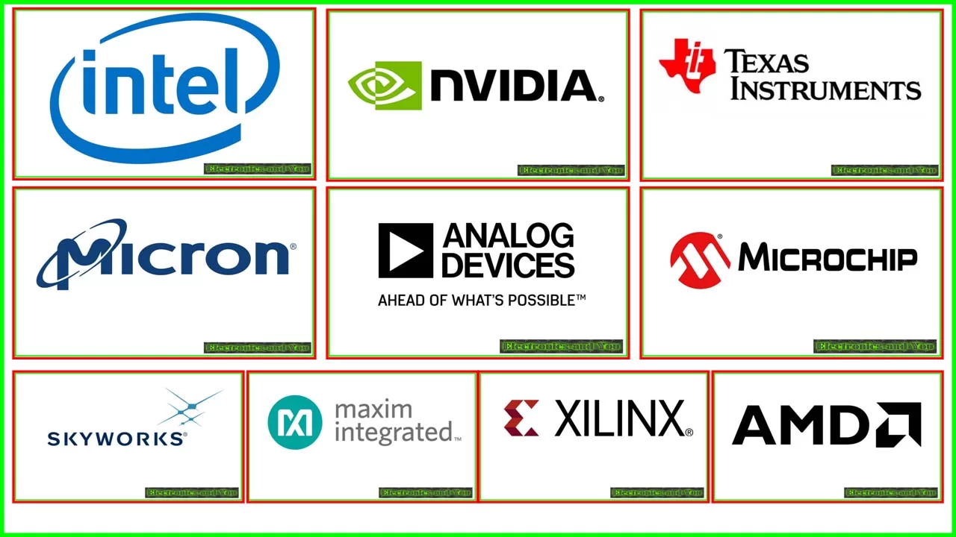

Where can you work with skills you will learn?

Slide 10
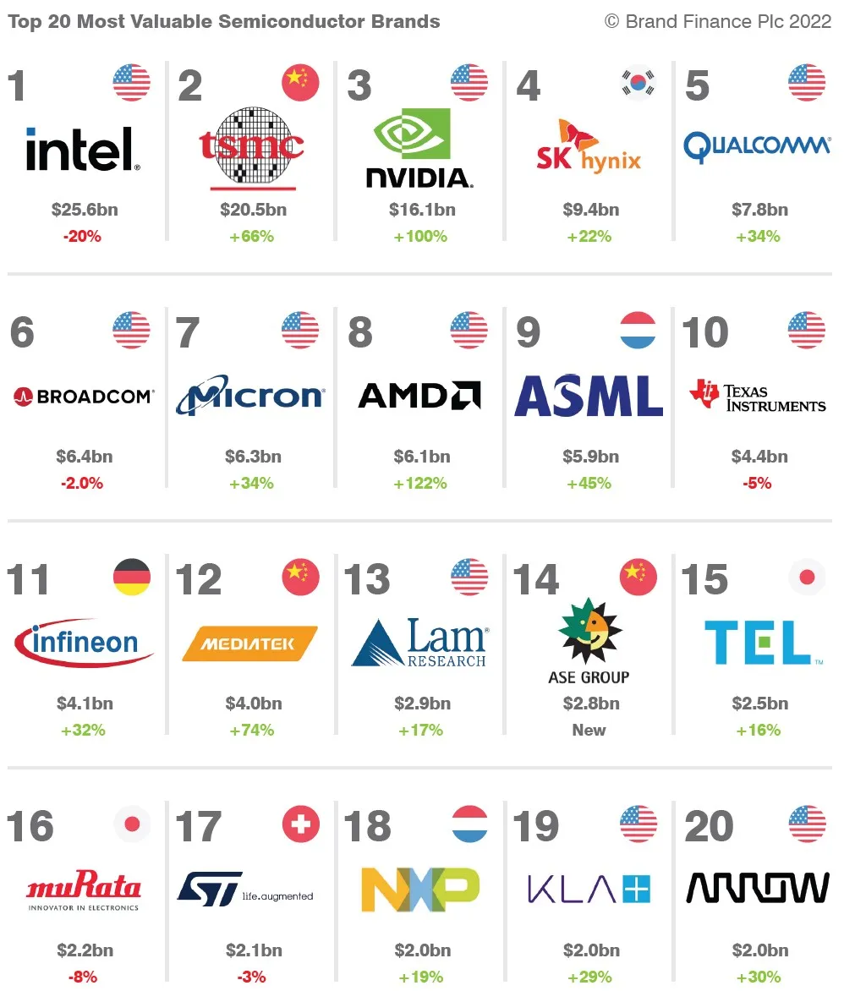
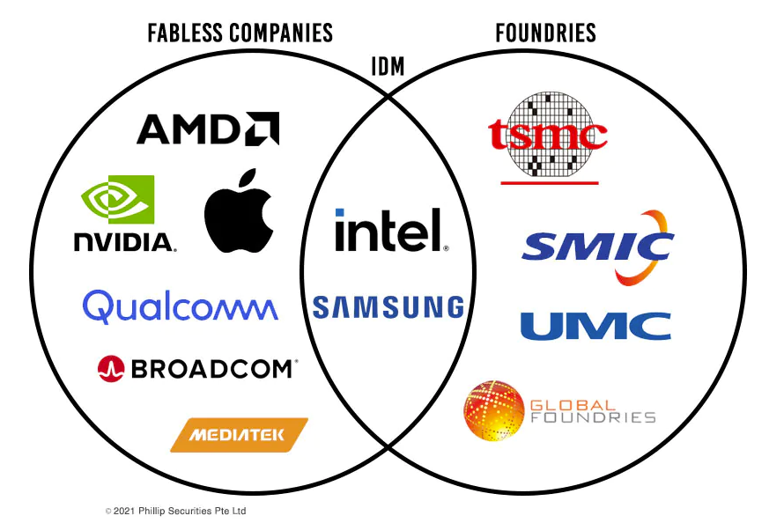

Slide 11


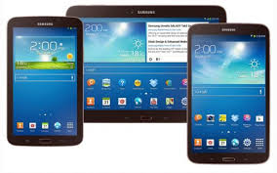
Many Computing Platforms

Slide 12
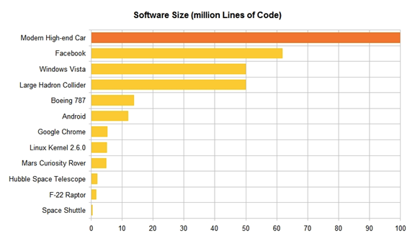
Course Context – Software Comparisons

Slide 13
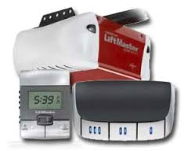
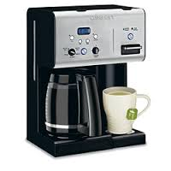
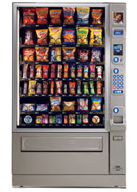
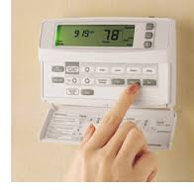

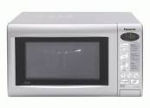
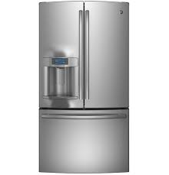
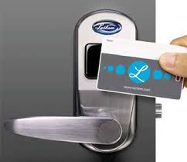
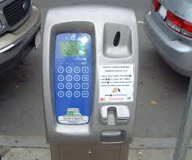
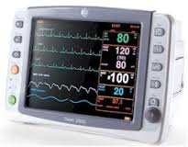
Embedded Systems Everywhere

Slide 14
Goal of the Course
Multiple levels of computer operation
Application level
High Level Language(s), HLL, level(s) CPE 211, 212
Assembly/machine language level: instruction set CPE 221
System architecture level: subsystems & connections CPE 221
Digital logic level: gates, memory elements, buses EE 202
Electronic design level EE315
Semiconductor physics level EE310
Interactions and relations between levels
View of machine at each level
Tasks and tools at each level
Historical perspective
Trends and research activities

Slide 15
What’s computer?
Anything that conducts mathematical calculations.

Slide 16
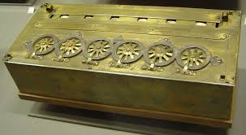
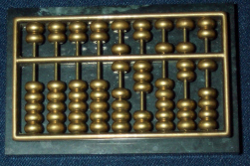
Mechanical Computers
Pascal’s adding machine Abacus

Slide 17
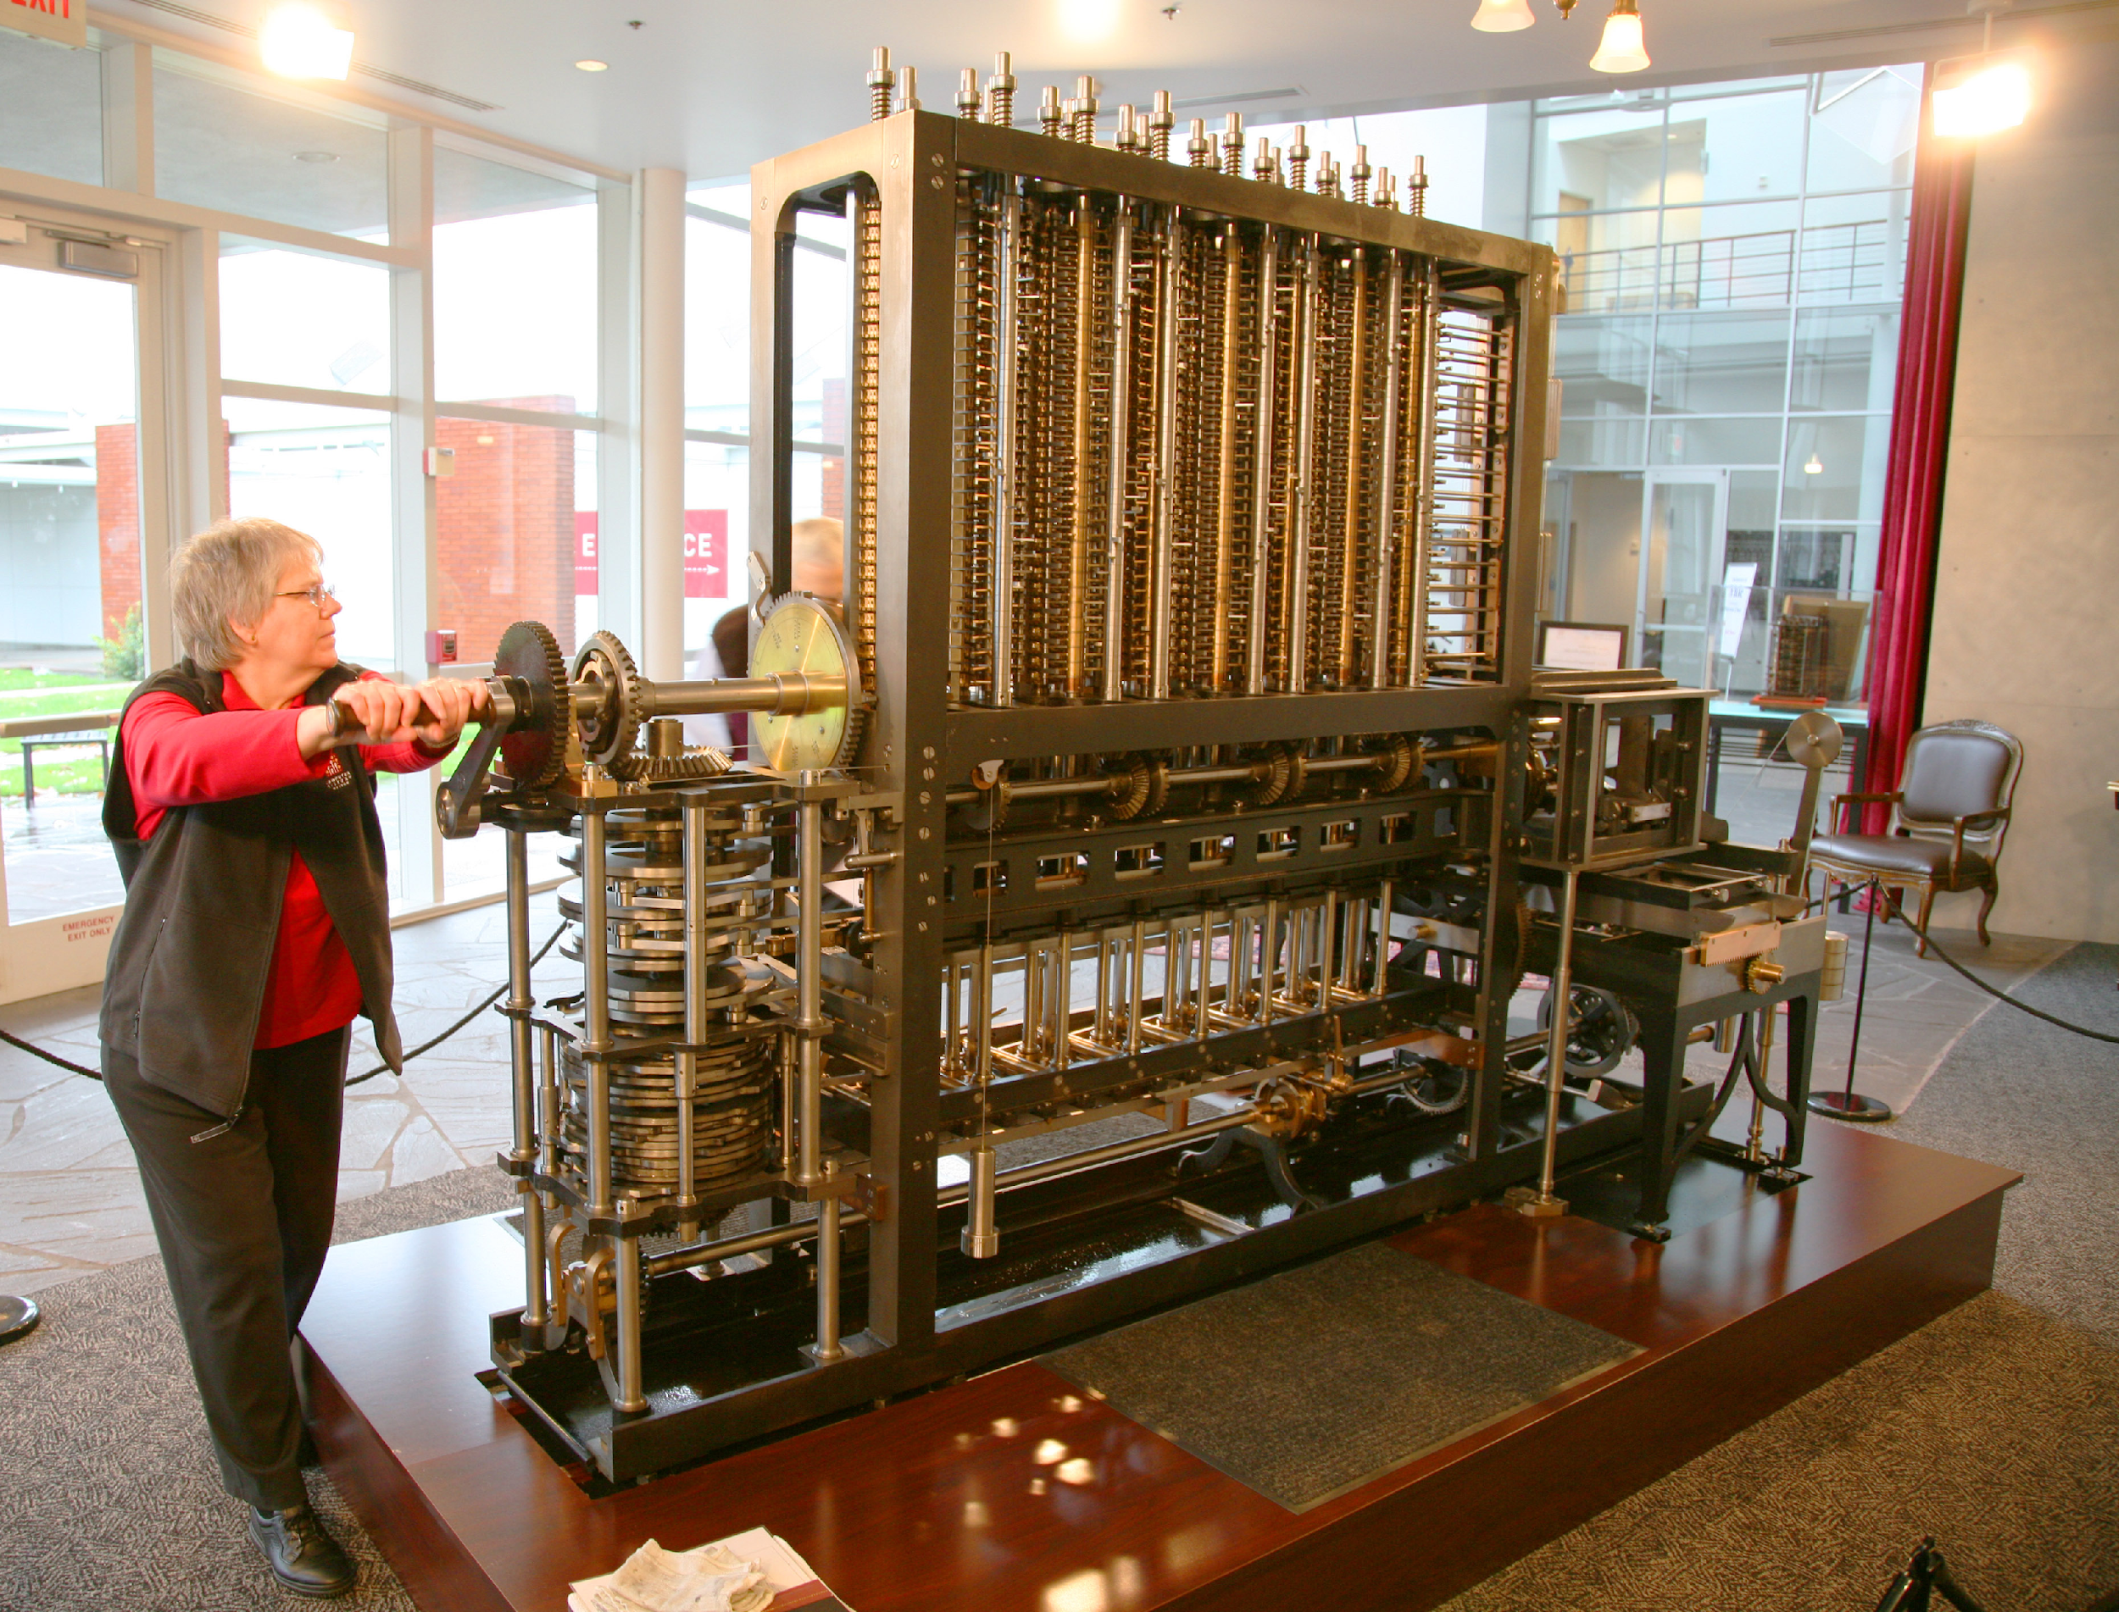
Difference and Analytical Engine

Slide 18
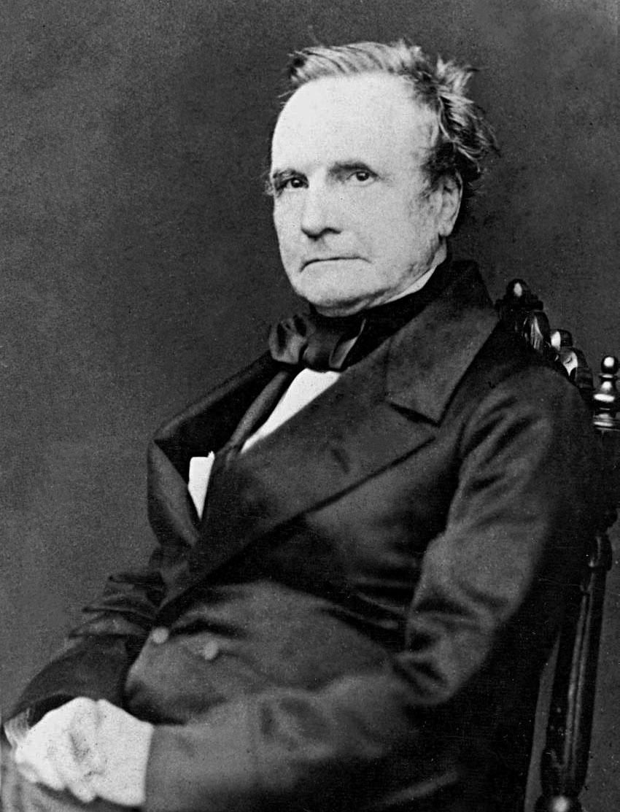
Origin of Modern Computers
Charles Babbage
Known as the first computer engineer
Designed the Difference and Analytical Engine
Couldn’t get it done by himself and died before finishing it
Queen Victoria funded his project
Goal was to help in selection of winning horses in the races.

Slide 19
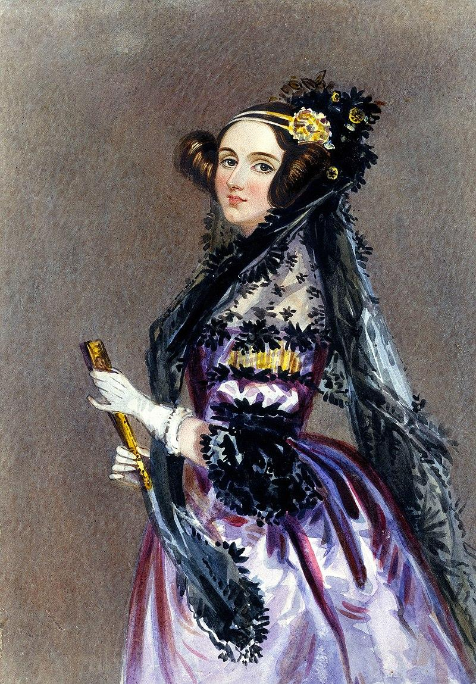
Origin of Modern Computers
Augusta Ada King, Countess of Lovelace
Considered the first computer scientist
Born over 100 years before the ENIAC was entering design
Translated, documented, and analyzed the algorithm that the machine used.

Slide 20
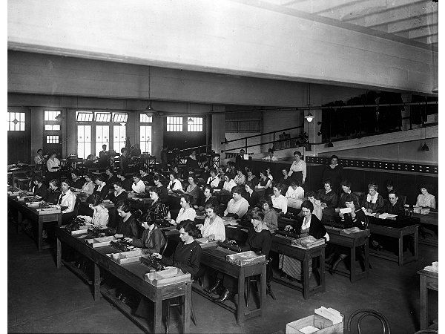
Origin of Modern Computers
“Kilo Girls”: Computing Power Used to Be Measured in 'Kilo-Girls' (https://www.theatlantic.com/technology/archive/2013/10/computing-power-used-to-be-measured-in-kilo-girls/280633/)
Responsible for gigabytes of data crunching throughout WW2

Slide 21
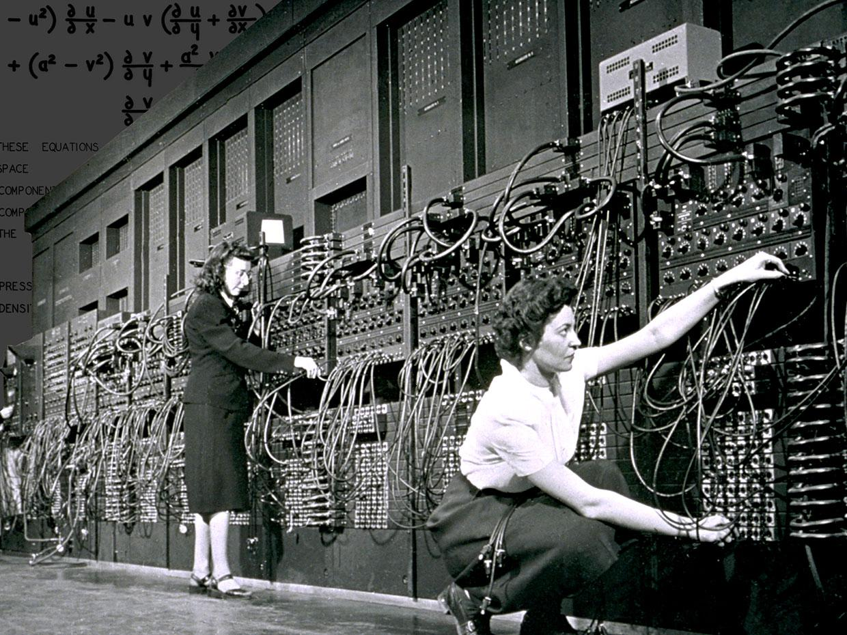
Origin of Modern Computers
Electronic Numerical Integrator and Computer (ENIAC)

Slide 22
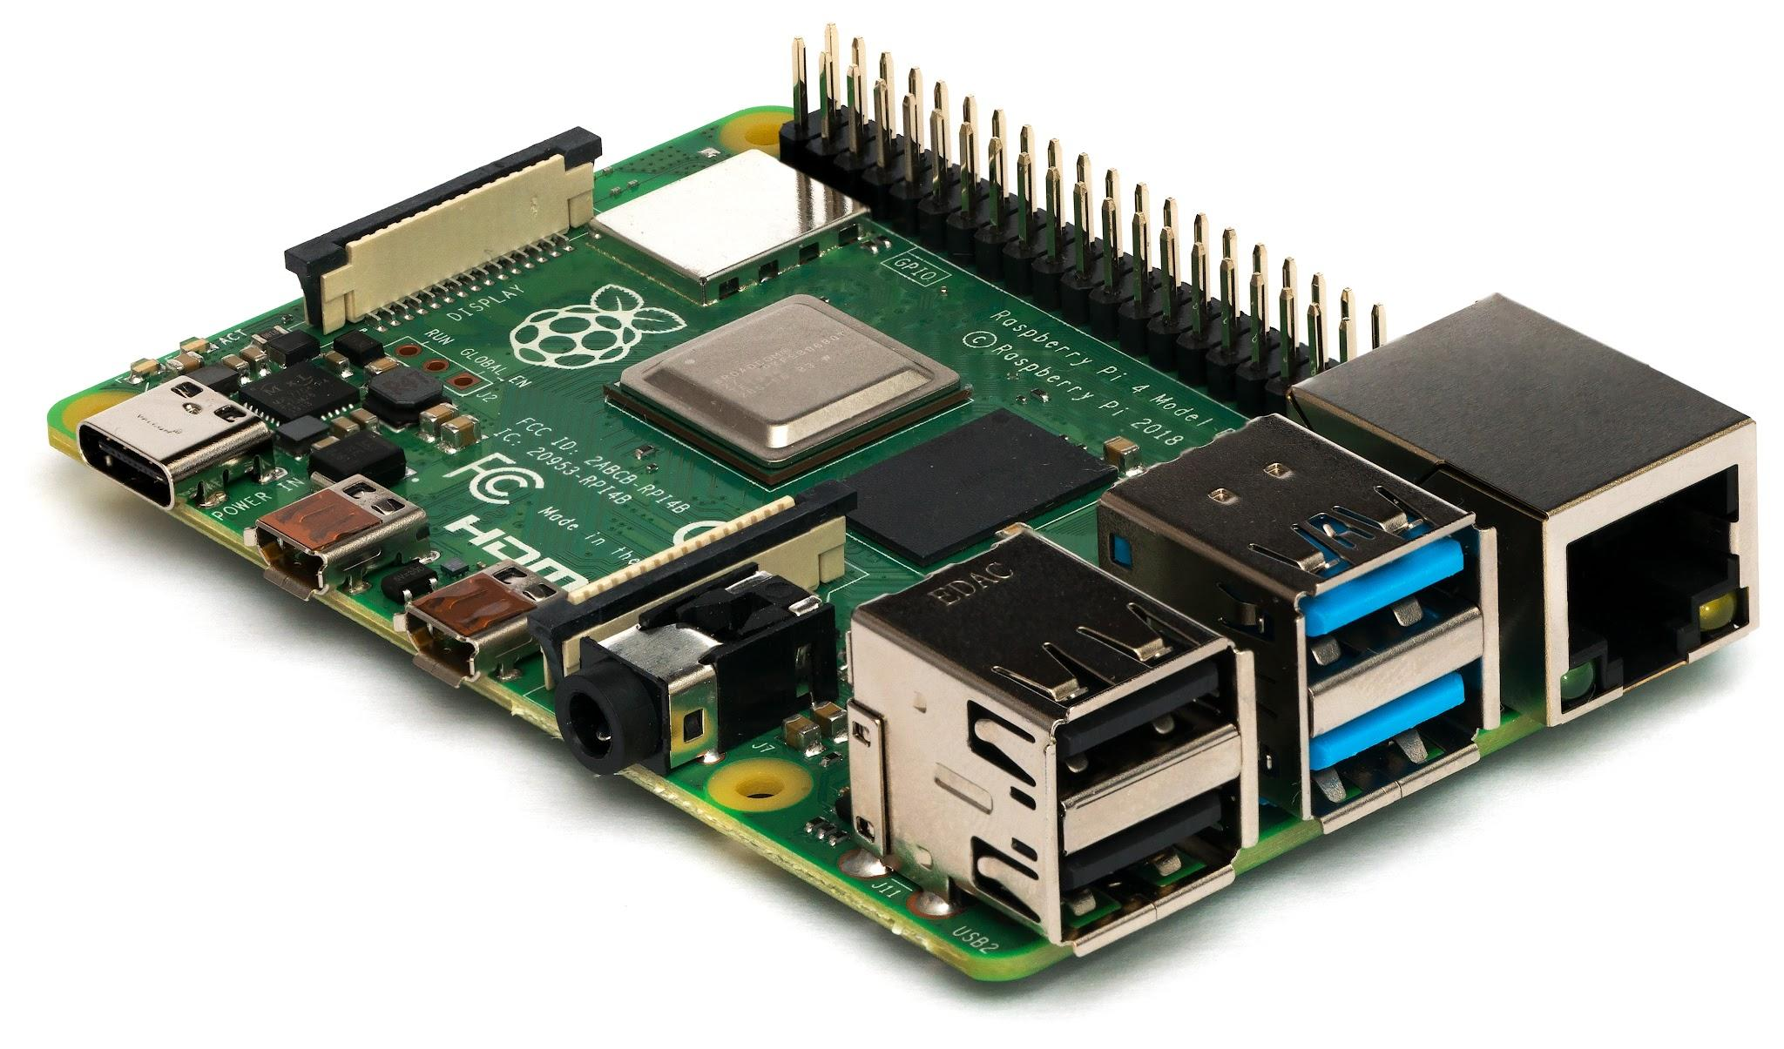
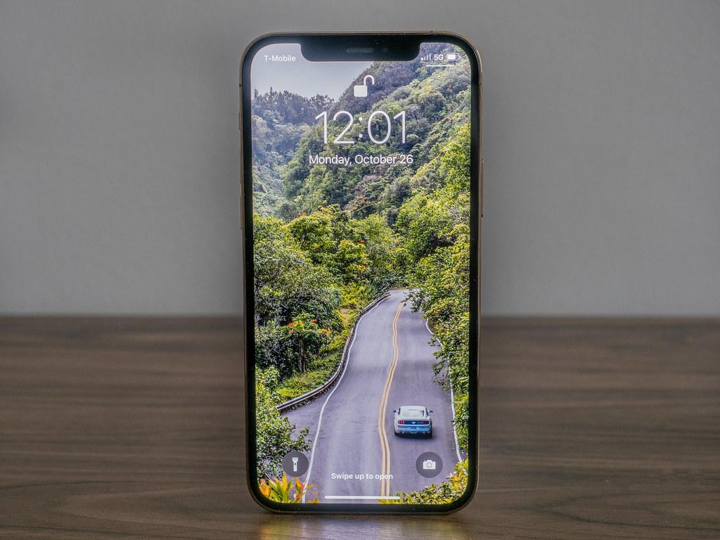
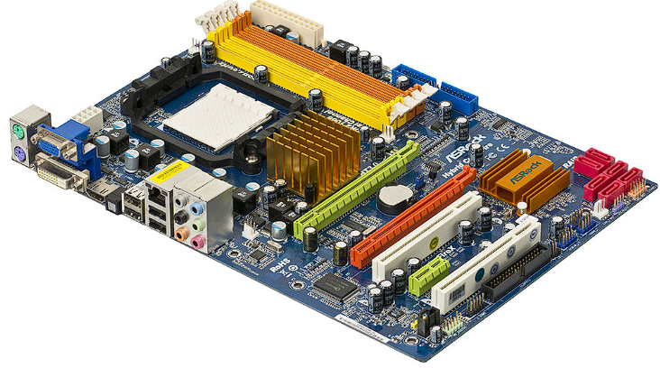
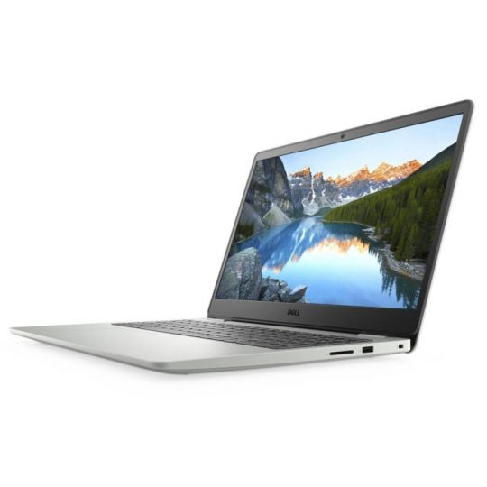
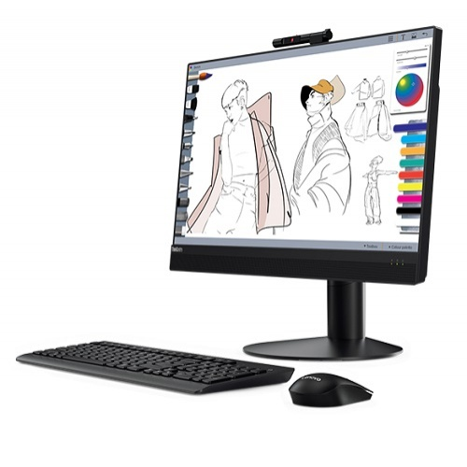
Modern Computers

Slide 23
What *should* a (modern) computer have?
Required
Processing Unit (CPU)
Memory
Optional
Graphics Processing Unit (GPU)
Audio Processing Unit (Sound card)
Mouse
Keyboard
Monitor
etc

Slide 24
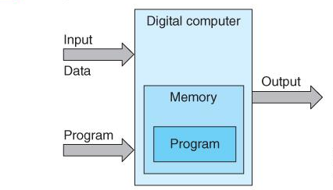
What’s a Computer?
Computers are dedicated or general-purpose
Dedicated (Embedded) – CPE 323, also specialized hardware (CPE 322/324)
General Purpose (CPE 221)
It can be programmed to solve any problem (within its Limitations)
A key feature of almost all general-purpose computers is that the program and its data are held in the same memory
This kind of computer is called Von Neumann Architecture (alternate is called Harvard architecture, but this means something different)

Slide 25
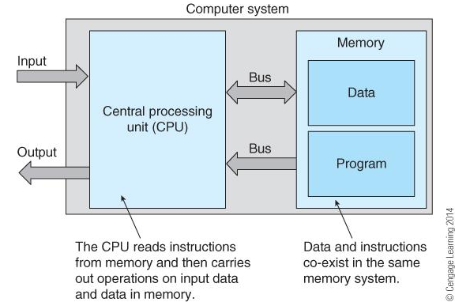
What is a Computer? (More Details)
We take data and instructions out of Memory and put them in Registers on the CPU for faster access
A Register is specified in terms of the number of bits it holds, typically 32 or 64-bit for modern PCs, smaller for embedded systems.

Slide 26
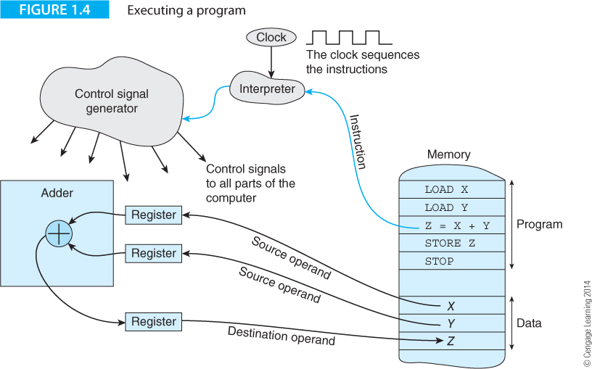
Program Execution
Everything happens at the direction of the Clock.
The Actions of the hardware support the Operations of a High level language such as A = B, or C = A + B.
The operation shown below is Z = X + Y.

Slide 27
The Stored Program Computer
A computer is a tool to solve problems
Dumb, but very powerful and can follow instructions
Consider the problem of finding the longest sequence of repeated digits in a stream of digits.
In the figure shown, the longest run of repeated digits is four consecutive sixes.
String of 17 digits
2
3
2
7
7
3
6
6
6
6
4
7
9
2
2
2
1
Run of four consecutive digits with the same value
Run of three consecutive digits with the same value

Slide 28
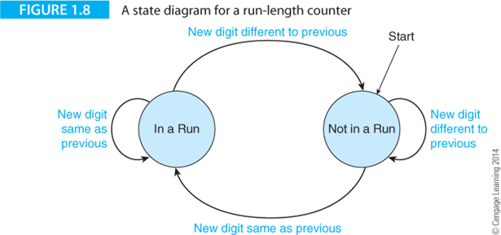
The Stored Program Computer
State diagram shows the states the computer can take, and the conditions needed to move from one state to another. A modern computer would have a state diagram too complex to read comfortably.

Slide 29
The Problem Solution (Pseudocode)
i The current position in the string
New_Digit The value of the current digit just read
Current_Run_Value The value of the elements in the current run
Current_Run_length The length of the current run
Max_Run The length of the longest run we’ve found so far
Read the first digit in the string and call it New_Digit
Set the Current_Run_Value to New_Digit
Set the Current_Run_Length to 1
Set the Max_Run to 1
REPEAT
Read New_Digit
IF New_Digit is the same as Current_Run_Value
THEN Current_Run_Length = Current_Run_Length + 1
ELSE {Current_Run_Length = 1
Current_Run_Value = New_Digit}
IF Current_Run_Length > Max_Run
THEN Max_Run = Current_Run_Length
UNTIL no more digits to read
Identifies the length of the longest contiguous run of the same digit in a string of digits.

Slide 30
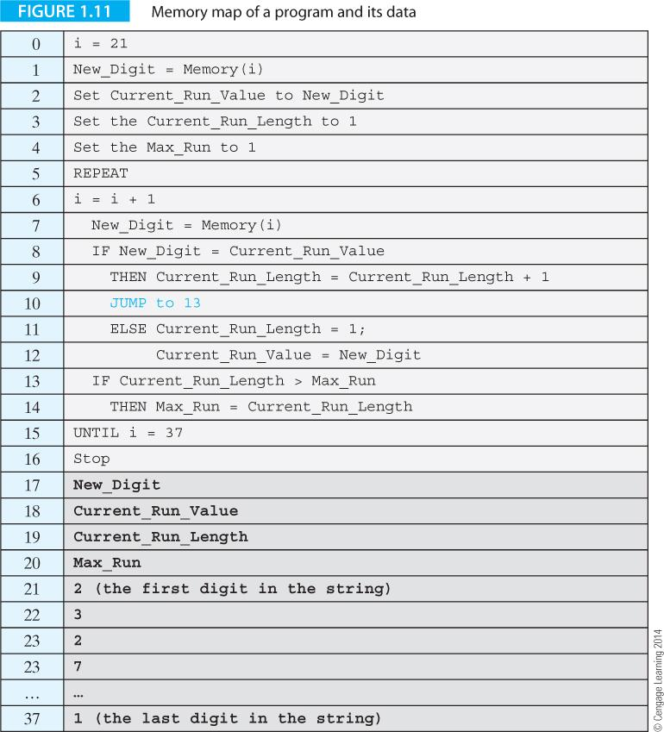
The Problem Solution (Language)
Instructions
Data

Slide 31
What does a computer need to solve a problem?
Needs to be able to start running a program at a specific location (line) or memory address
Once finished with current instruction by default it has to go to the next location (line)
Read or get data from memory. Use symbolic names line X, location to reference the memory locations.
Set memory to a specific value
Update something from memory (add 1)
Store a value back out to memory
Loop or jump to a specific instruction
Conditional behavior. Check a value against another value and branch or not branch depending on the result.

Slide 32
The Stored Program Concept
Stored_program_machine
Point to the first instruction in memory
REPEAT
Read instruction at the memory location pointed at
Point to the next instruction
Decode the instruction read from memory
Execute the instruction
FOREVER
End

Slide 33
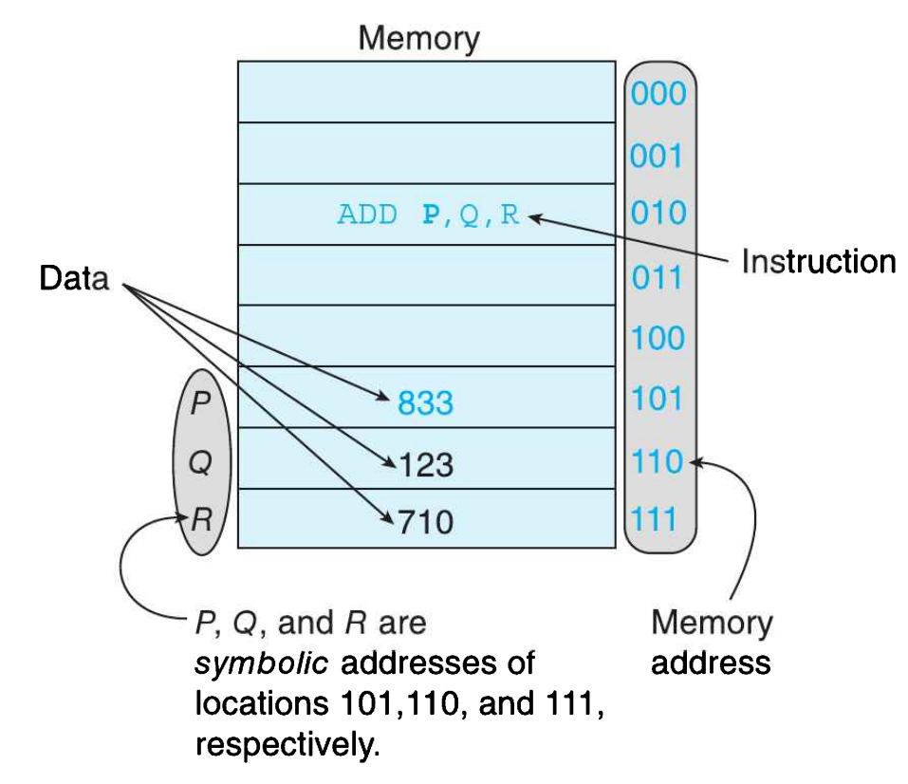
An Instruction and its Operands

Slide 34
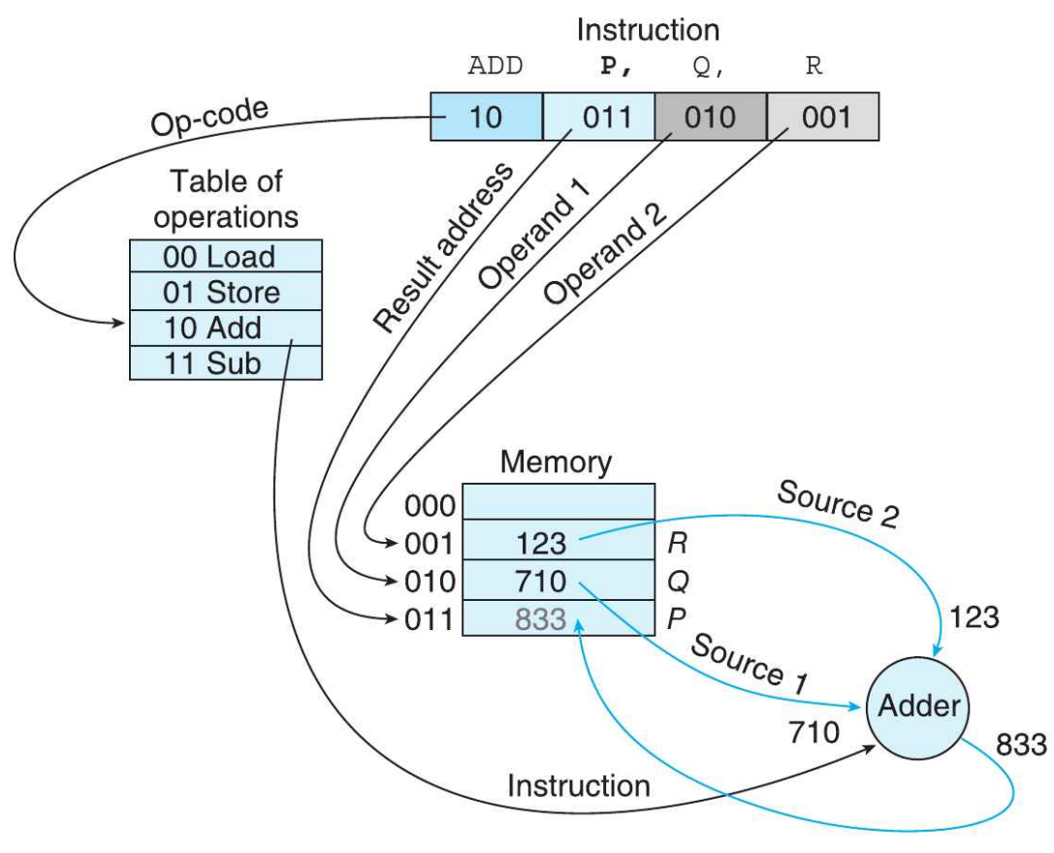
The Three-Address Instruction
Interpreting the instruction
ADD P, Q, R

Slide 35
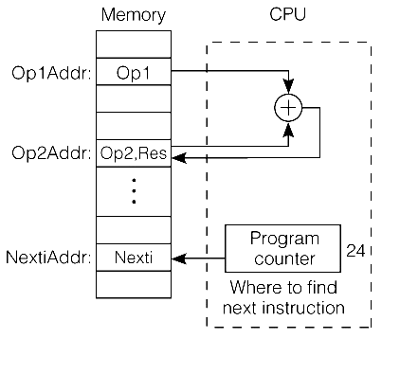
The Two-Address Instruction
Two-address instruction of the format:
Operation Address1 Address2
Address2 is source operand
Address1 is both source and destination operand.
[P] ← [P] + [Q]
add Op2, Op1 (Op2← Op2 + Op1)
8
24
24
Bits:
add | Op2Addr | Op1Addr
which operation
where to find operands
where to put the result

Slide 36
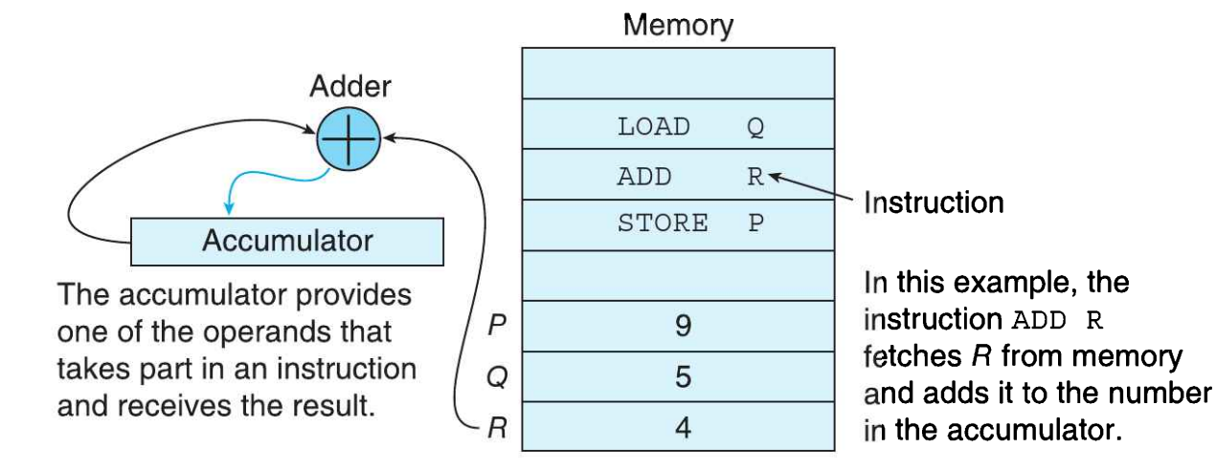
The One-Address Instruction

Slide 37
Introducing Register Transfer Level (RTL) Notation
RTL is a notation used to define operations. Square brackets indicate the contents of a memory location. The expression [15] = Max_Run means “the contents of memory location 15 contains the value of Max_Run”.
The backward arrow symbol, ←, indicates a Data Transfer.

Slide 38
RTL Example
For example, [15] ← [15] + 1 is interpreted as “the content of memory location 15 is increased by 1 and the result put in memory location 15”.
Consider:
R1 ← 25: Put 25 in Register R1
M[20] ← 6: Put 6 in memory location 20
M[20] ← M[6]: Copy the content of memory location 6 into memory location 20
R1 ← R6: Copy the content of register R6 into R1

Slide 39
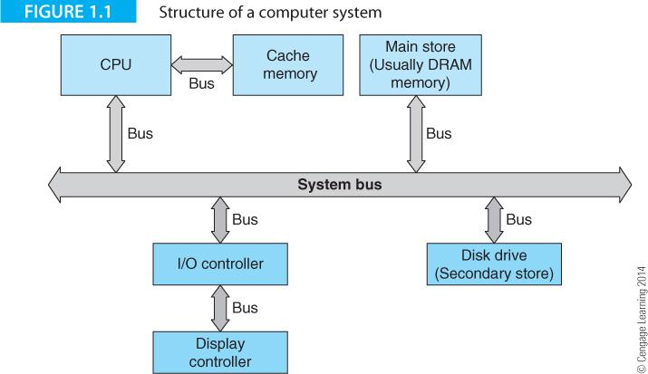
Structure of a Computer System
One challenge is that subsystems improve at different rates. For decades, processors improved faster than hard drives. As solid-state drives become more prevalent, this problem is alleviated for now. At the same time, processors are now power-limited and increases in clock speeds are no longer possible so we now must make multi-cores work.

Slide 40
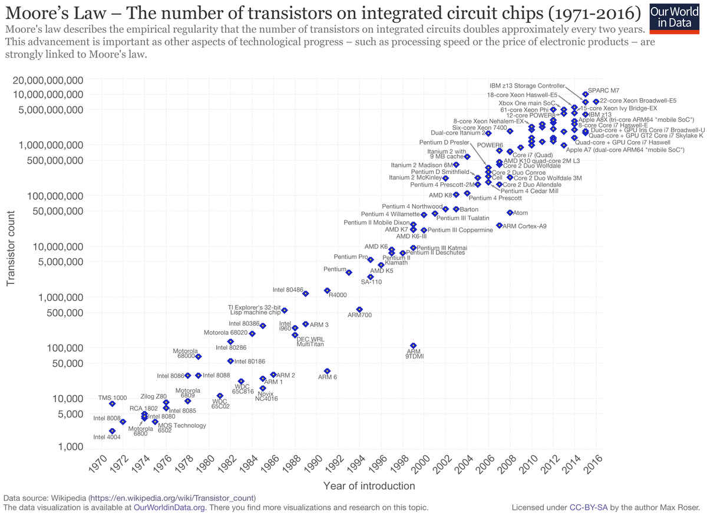
Moore’s Law

Slide 41
Technological Obstacles
Power Wall
Energy isn’t infinite, so energy consumption cannot continue to expand forever
Heat Wall
Wires heat up when conducting. Add enough wires, eventually enough heat accumulates to damage the material
C Wall
Electricity cannot move faster than the speed of light
Atomic Wall
Wires can be placed only so close together before the current will arc

Slide 42
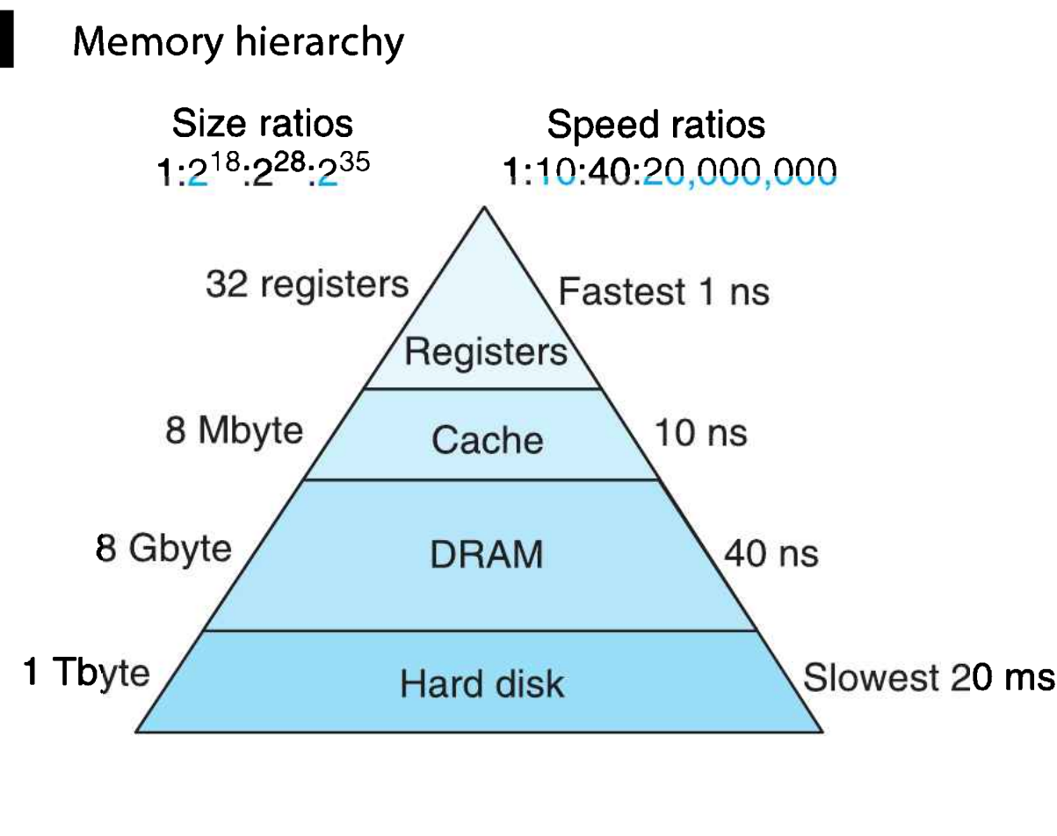
Overview of the Computer System - Memory Hierarchy

Slide 43
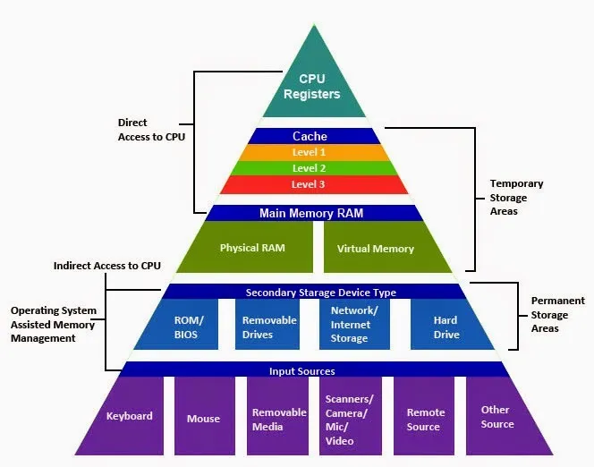
Overview of Data Storage

Slide 44
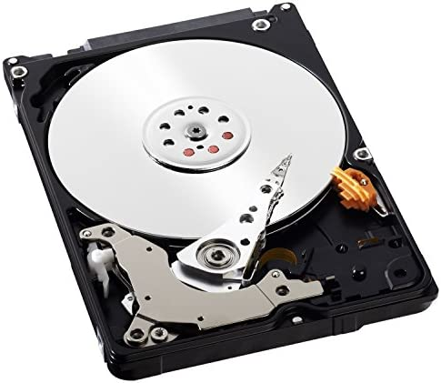
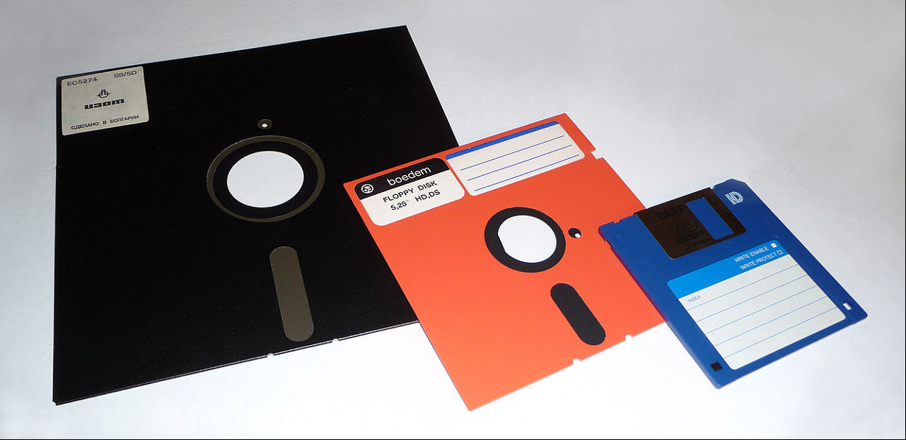
Old Secondary Storage
Then came CDs and other Optical disk drives, like DVDs

Slide 45


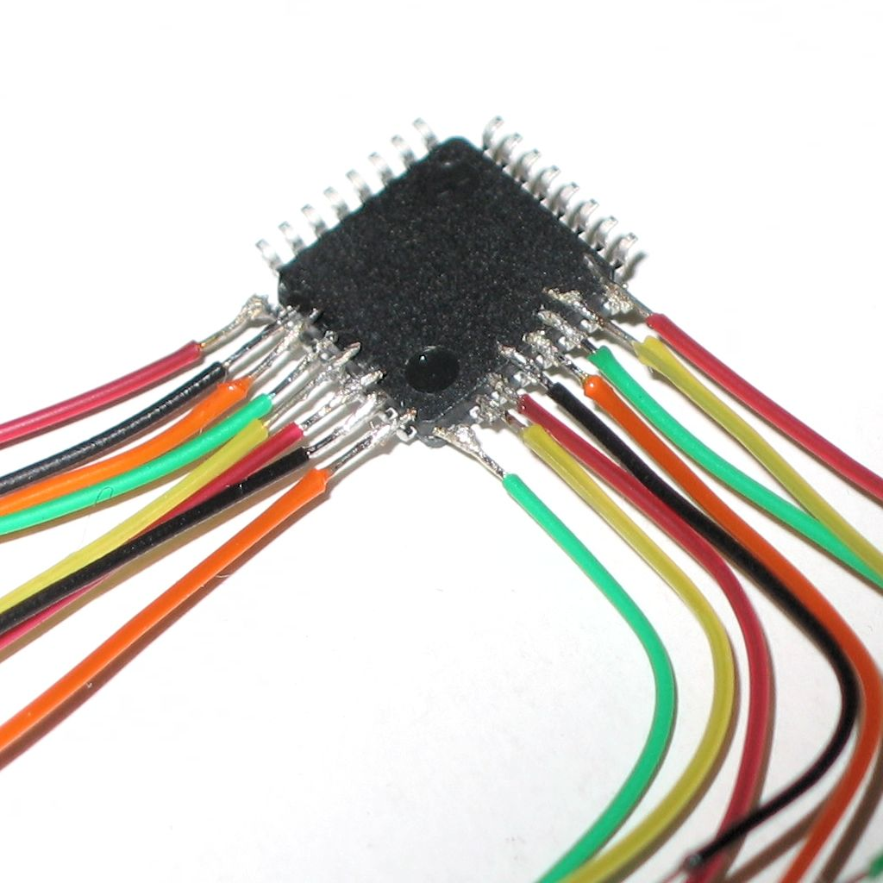

What’s a Bus?
Strictly speaking, it is only a wire that connects two devices together. That’s all a bus is at its base level.
However, the protocols used to govern the behavior of signals across a bus can be quite complicated

Slide 46
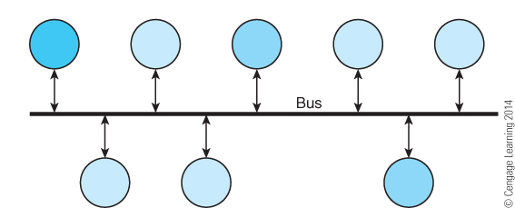
Overview of the Computer System – Simple Bus
Having a single bus “highway” means all the nodes must wait their turn to use the wire.

Slide 47
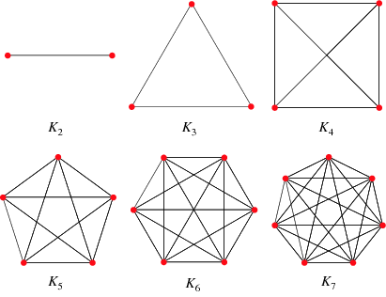
Overview of the Computer System – Simple Bus
Point to point buses would be faster and simpler to program, but manufacturing a chip would be impractical as the amount of wires required would make the logistics become prohibitively complicated.
Nodes | Edges
2 | (2*1)/2 = 1
3 | (3*2)/2 = 3
4 | (4*3)/2 = 6
5 | (5*4)/2 = 10
6 | (6*5)/2 = 15
7 | (7*6)/2 = 21
16 | (16*15)/2 = 120
32 | (32 * 31)/2 = 496
64 | (64 * 63)/2 = 2016

Slide 48
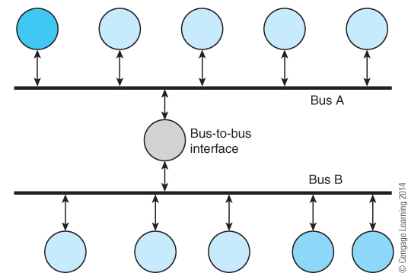
Overview of the Computer System - Buses

Slide 49
Some Important Terms
Instruction Set Architecture (ISA)
Computer Organization
MicroArchitecture
Machine Code
Assembly language code
Reduced Instruction Set Computer (RISC)
Complex Instruction Set Computer (CISC)
Moore’s Law
Applications
Clock
Central Processing Unit (CPU)
RAM
Algorithm
Program
Pseudocode

Slide 50
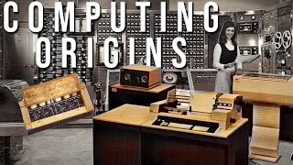
Video of the Day
https://www.youtube.com/watch?v=-M6lANfzFsM

